Slide 1
AI in Healthcare Assignment 4
MIMIC NLP

Slide 2
Preparing Data and Choosing a Target Disease

Slide 3
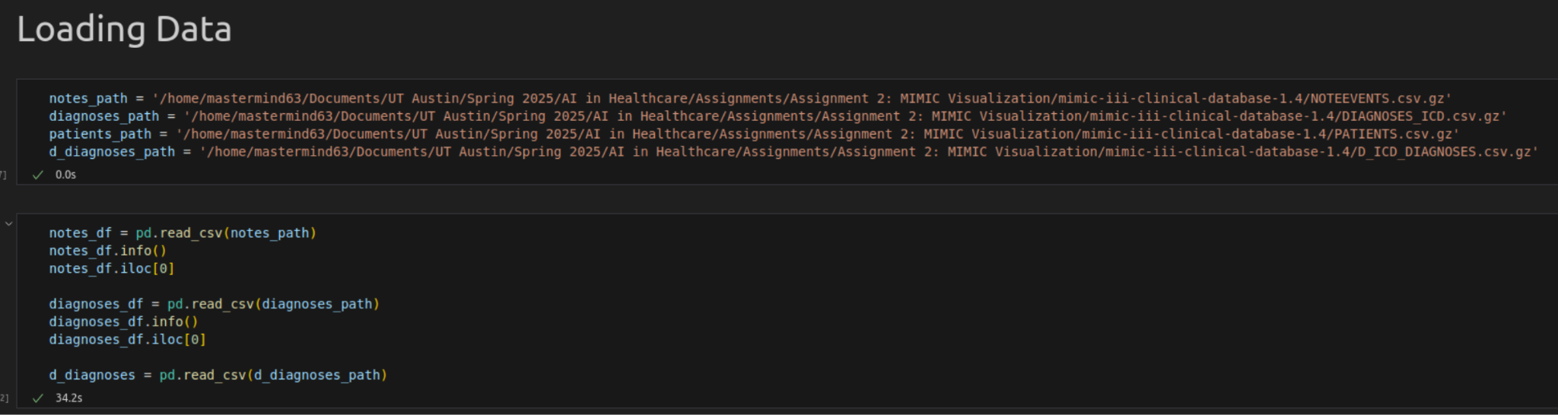
Loading Data
I loaded data from notes, diagnoses, and patients, as well as d_diagnosis

Slide 4
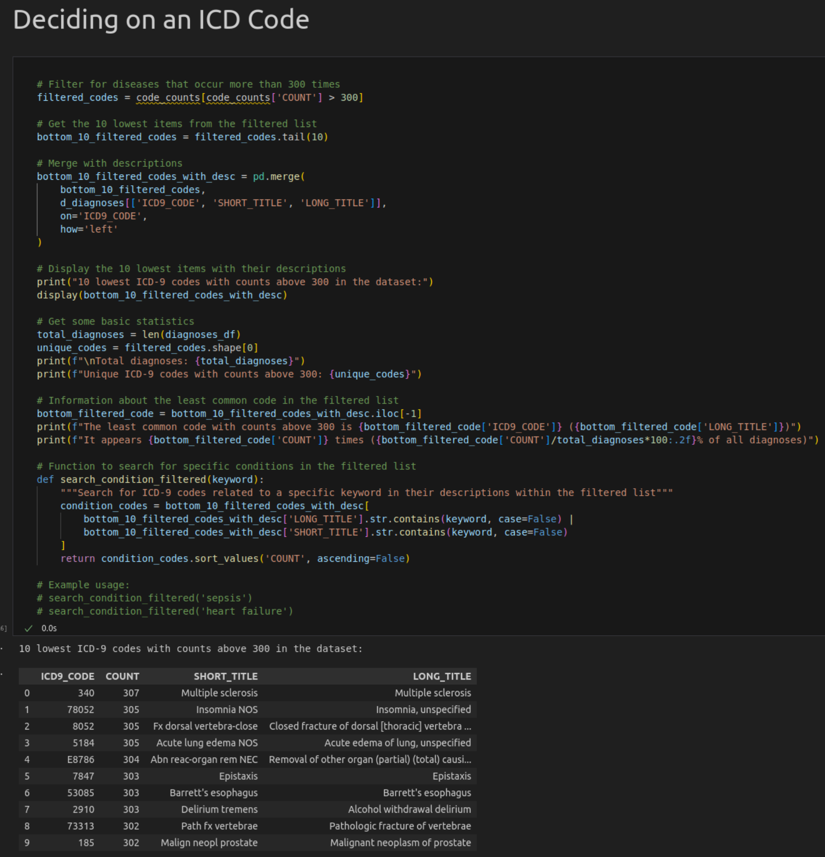
Deciding on an ICD Code
I wanted to pick an ICD code that had a large volume of notes and data to look through, but not so much that it would be difficult to work with. I ended up focusing in on two diseases:
Multiple Sclerosis
Unspecified Insomnia

Slide 5
2. Using Spacy on Medical Notes

Slide 6
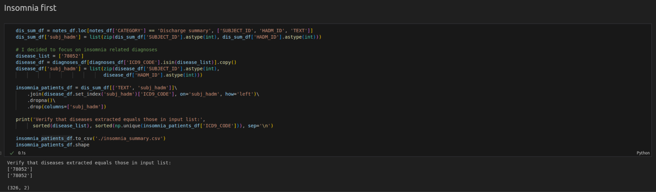
Using Spacy on Insomnia Notes - Filtering the Data
Parts of the dataloading and filtering of this code was inspired by a discussion post, and the examples given in lecture and at the end of the modules

Slide 7
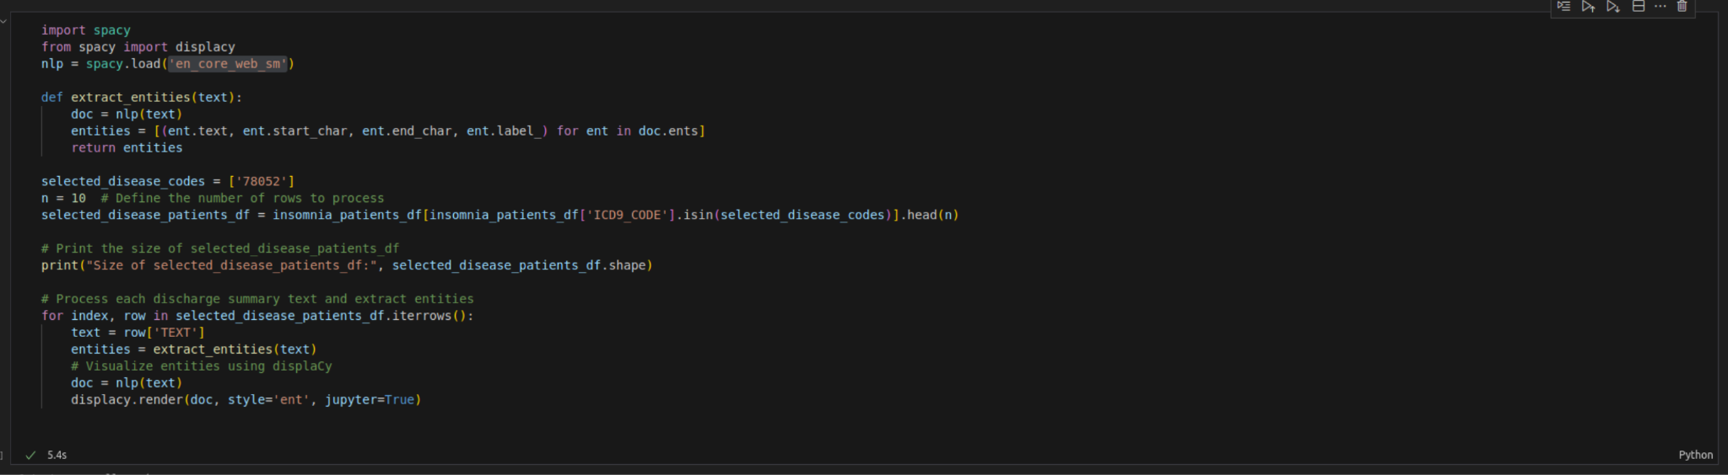
CODE: Using Spacy with the 'en_core_web_sm' model on Insomnia Notes
Here I use a function to extract entities, filter them to ensure they are all related to the chosen disease and code of insomnia, and then reduce the size there to make processing take less time

Slide 8
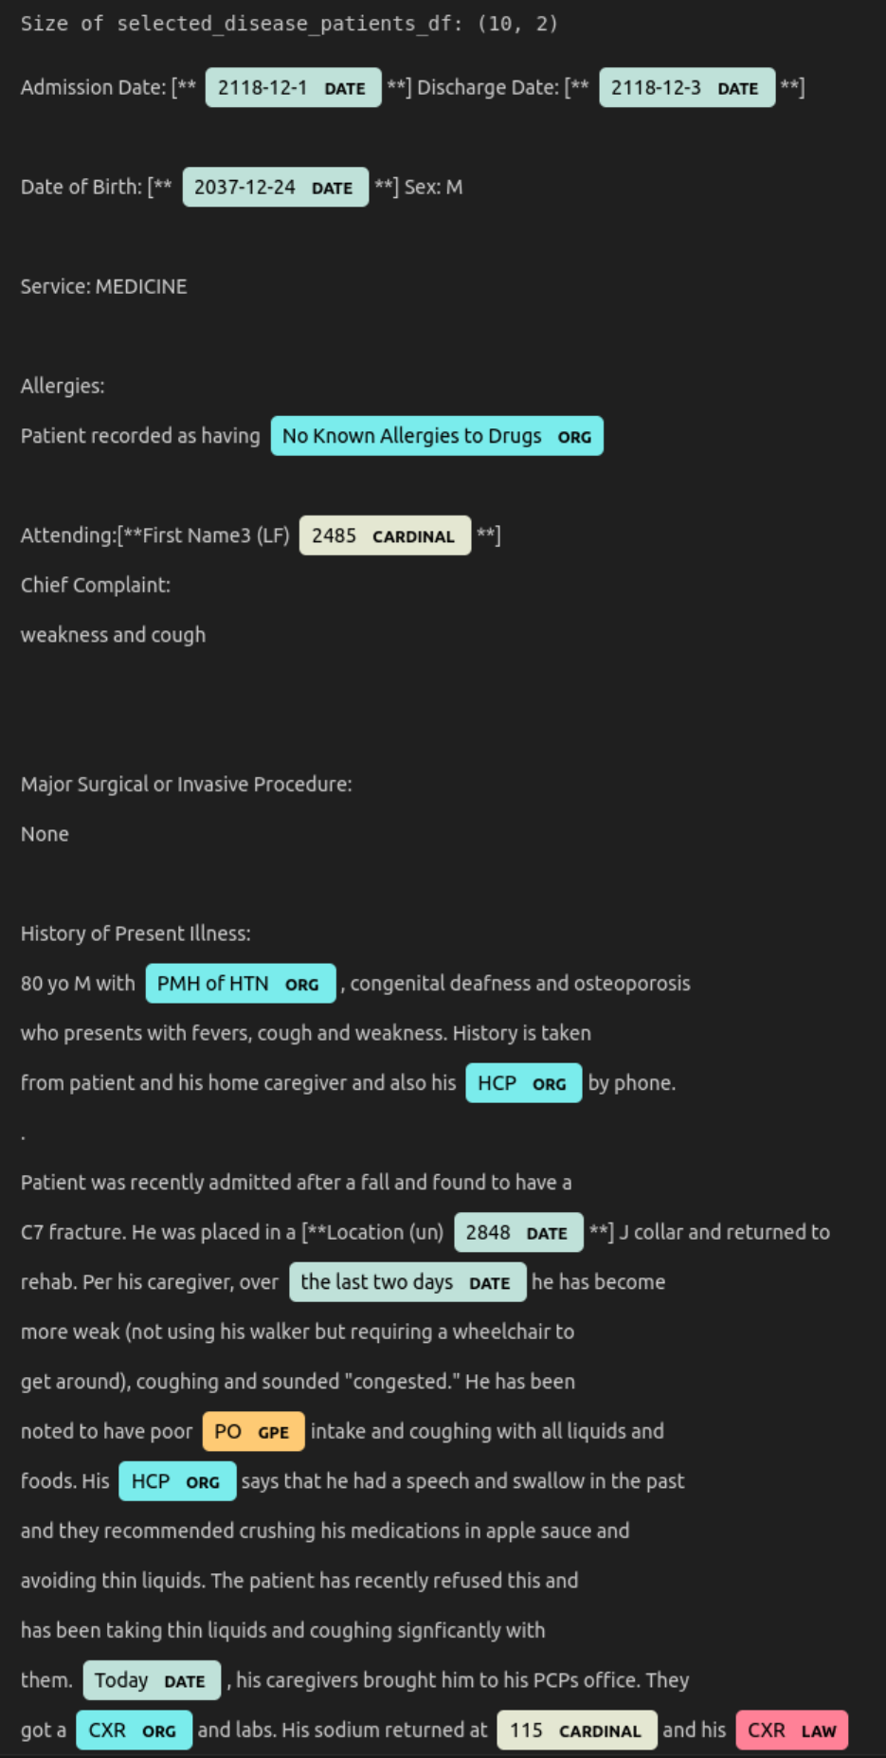
OUTPUT: Using Spacy with the 'en_core_web_sm' model on Insomnia Notes
Just using spacy delivers a mediocre output
Dates are properly captured
Organizations are hit or miss
Laws are not being pulled properly
We likely need to change out the model to be more specific to medical / healthcare data for descriptive outputs

Slide 9
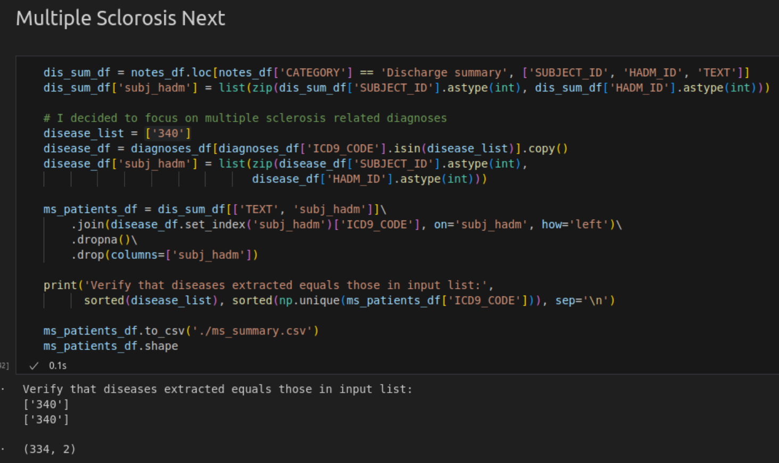
Using Spacy on M.S. Notes - Filtering the Data
This is the same as the dataloading before, but focused on ICD_9 code 340, which is used for Multiple Sclerosis

Slide 10
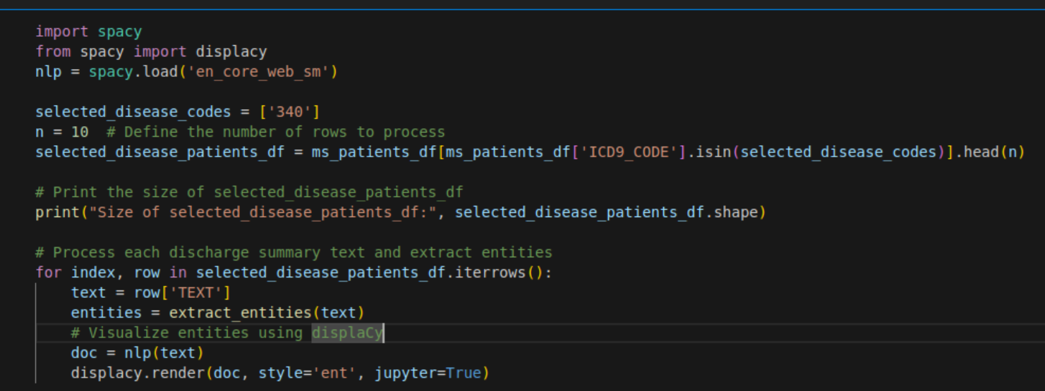
CODE: Using Spacy with the 'en_core_web_sm' model on M.S. Notes
This function similarly uses the en_core_web_sm model, which has limited success on healthcare specific data

Slide 11
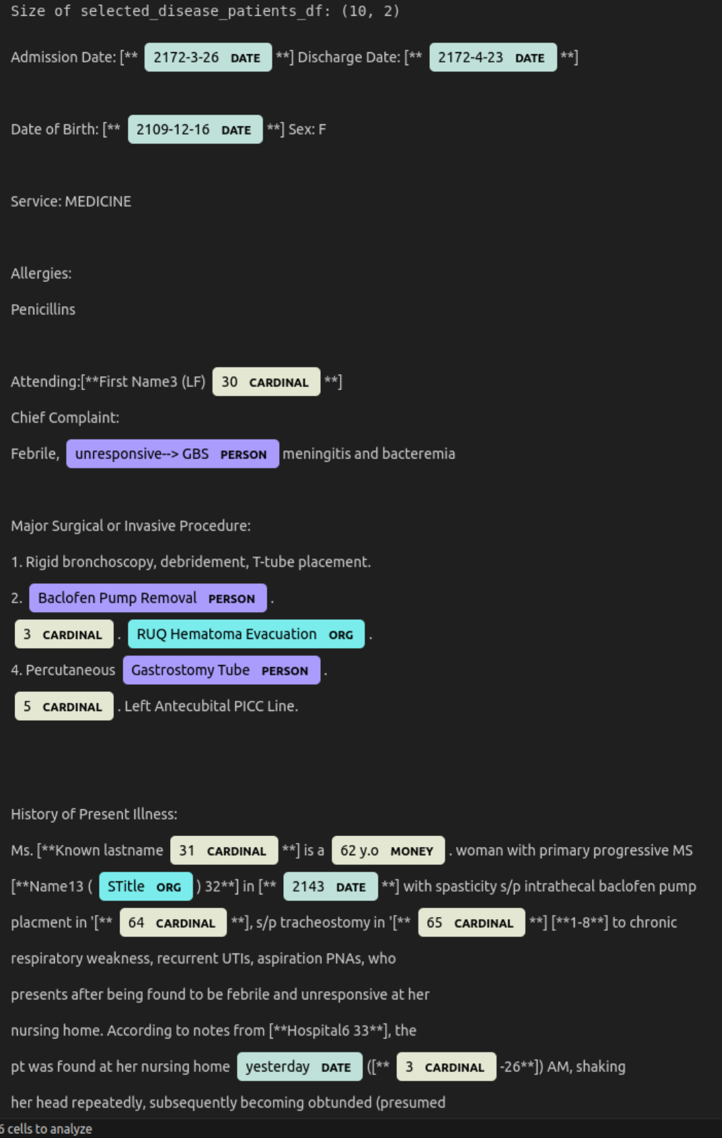
OUTPUT: Using Spacy with the 'en_core_web_sm' model on Insomnia Notes
Just using spacy delivers a mediocre output
Dates are properly captured
Incorrect tags for persons
Ages are being tagged as money
We likely need to change out the model to be more specific to medical / healthcare data for descriptive outputs

Slide 12
3. Using SciSpacy on Medical Notes

Slide 13
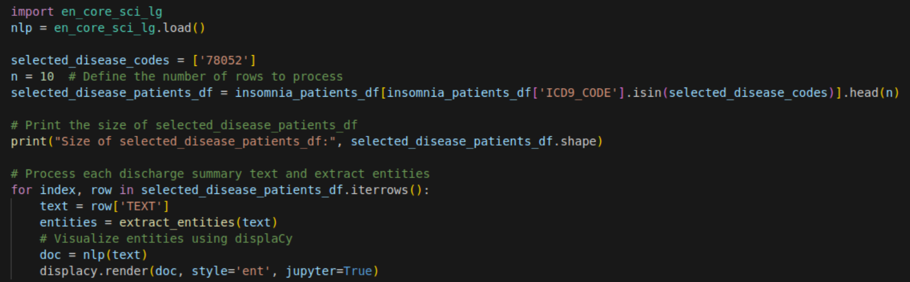
CODE: Using SciSpacy on Insomnia Notes - en_core_sci_lg
Dry code, not reusing the prior functions, but processing the entities and extracting them to be displayed

Slide 14
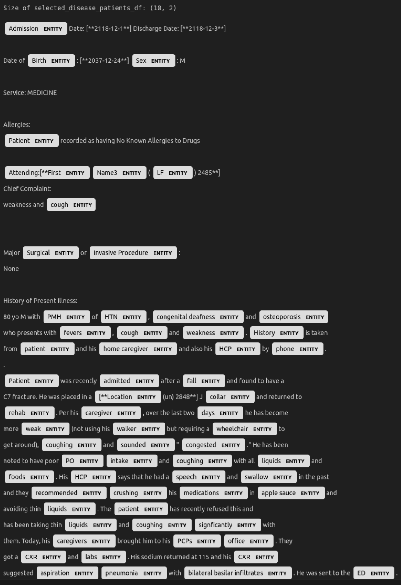
OUTPUT: Using SciSpacy on Insomnia Notes - en_core_sci_lg
Picks up lots of different types of entities, but does not label them very well
Much more dense than the prior model with detections of words, but less descriptive about what they are and mean
All items are considered ‘Entity’

Slide 15
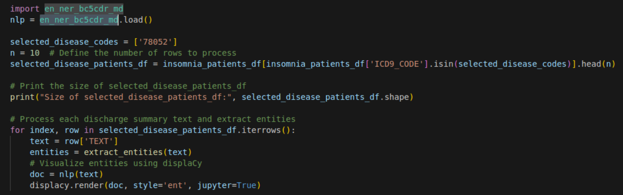
CODE: Using SciSpacy on Insomnia Notes - en_ner_bc5cdr_md
Same as the previous code, but this time using the en_ner_bc5cdr_md model to do entity extraction

Slide 16
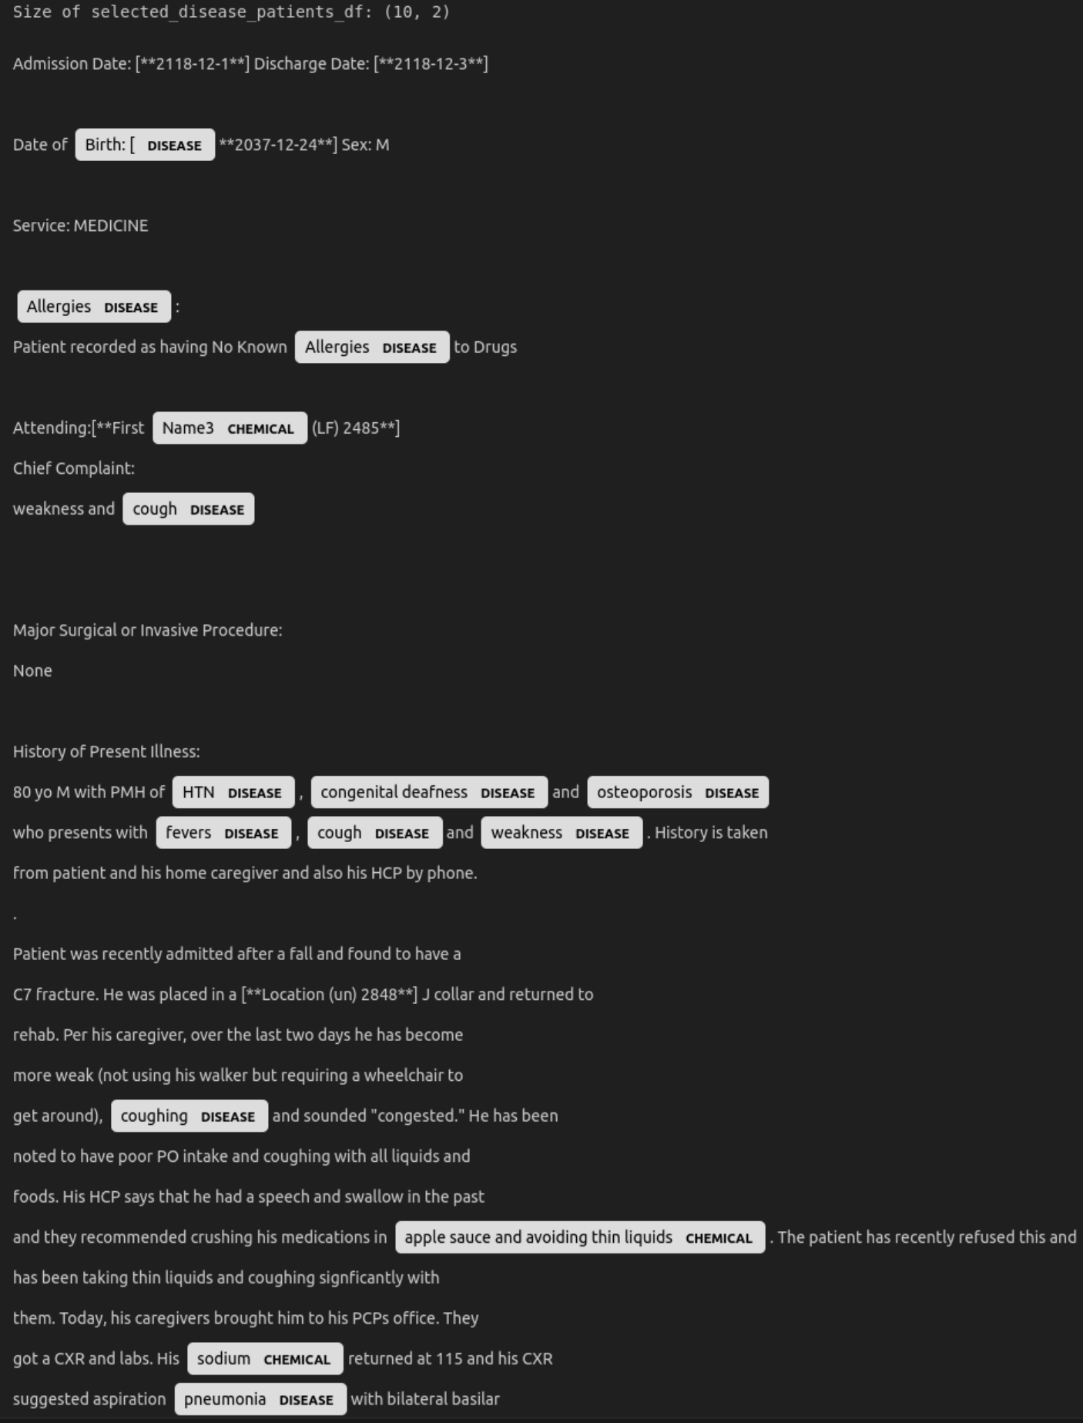
OUTPUT: Using SciSpacy on Insomnia Notes - en_ner_bc5cdr_md
Picks up diseases and chemicals somewhat adequately, but certainly does not catch ever disease and chemical
Misses common diseases
Chemical labels can be correct, but can also be incorrect fairly frequently
Birth[ is not a disease, but is tagged as such
Lets see if we fair any better using SciSpacy on Multiple Sclerosis notes

Slide 17
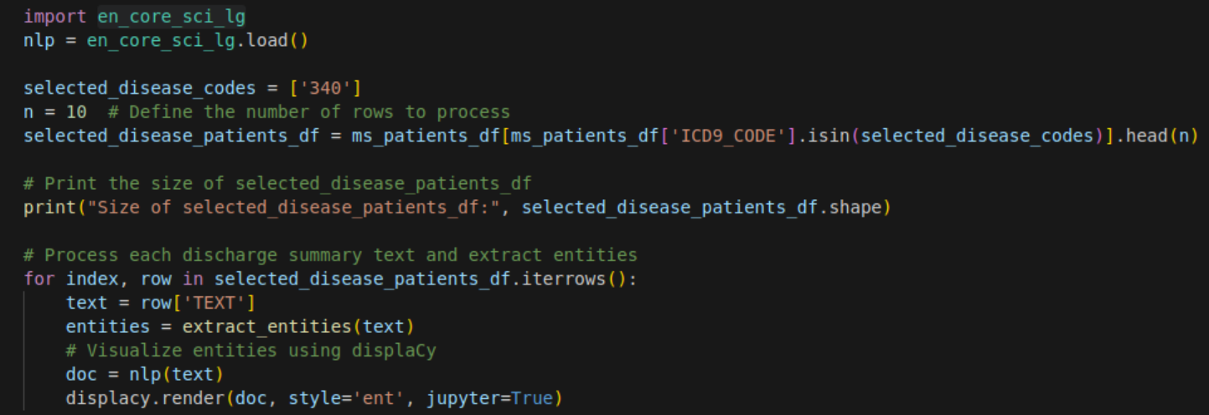
CODE: Using SciSpacy on M.S. Notes - en_core_sci_lg
Similar code as before but focusing on ICD_9 code ‘340’ for Multiple Sclerosis

Slide 18
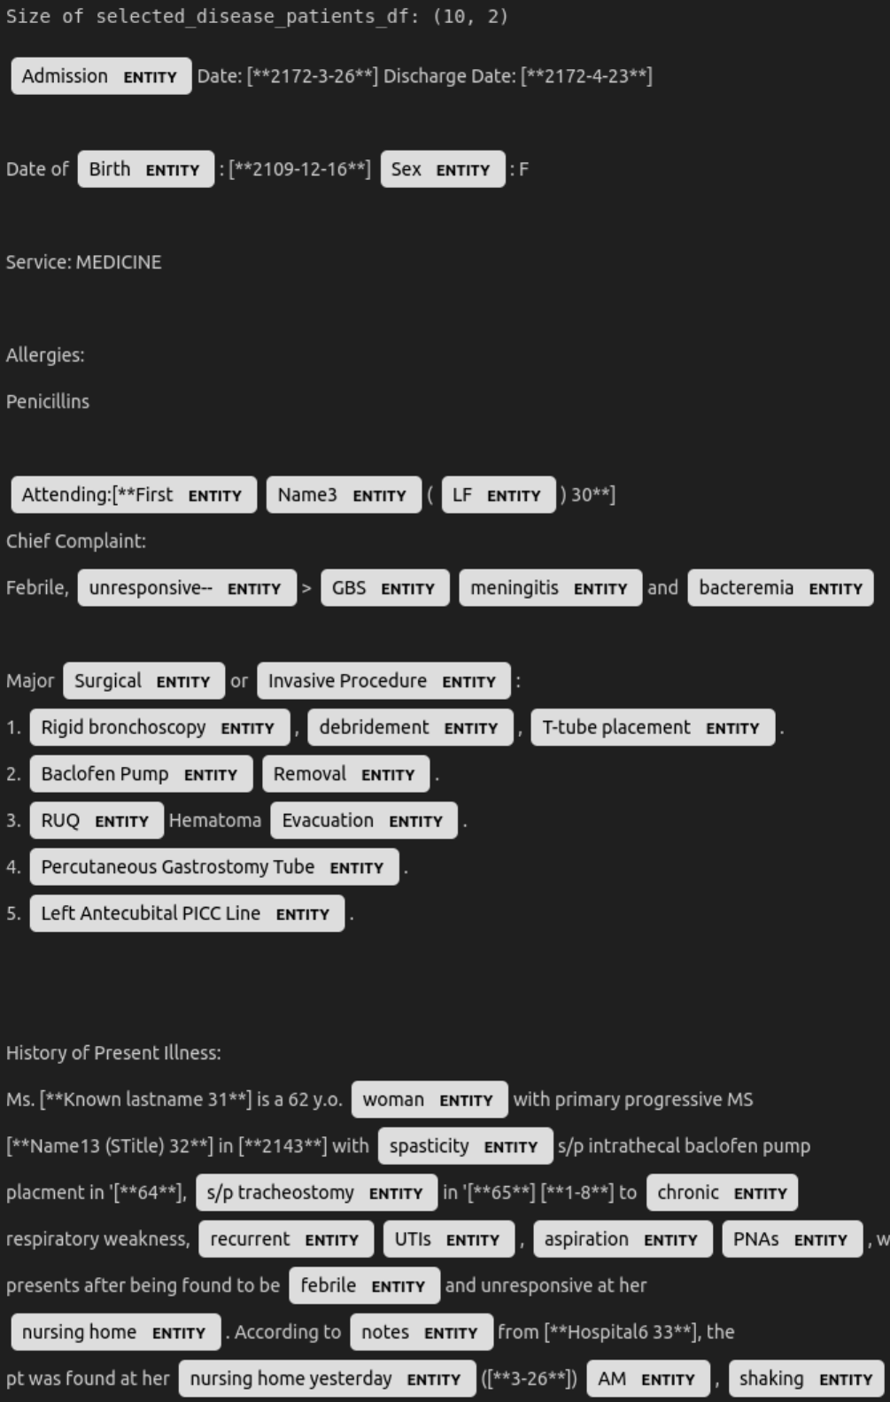
OUTPUT: Using SciSpacy on M.S. notes - en_core_sci_lg
Picks up lots of different types of entities, but does not label them very well
Much more dense than the prior model with detections of words, but less descriptive about what they are and mean
This seems to be a fair processor of MS related items, but without labeling may be tricky to use effectively

Slide 19
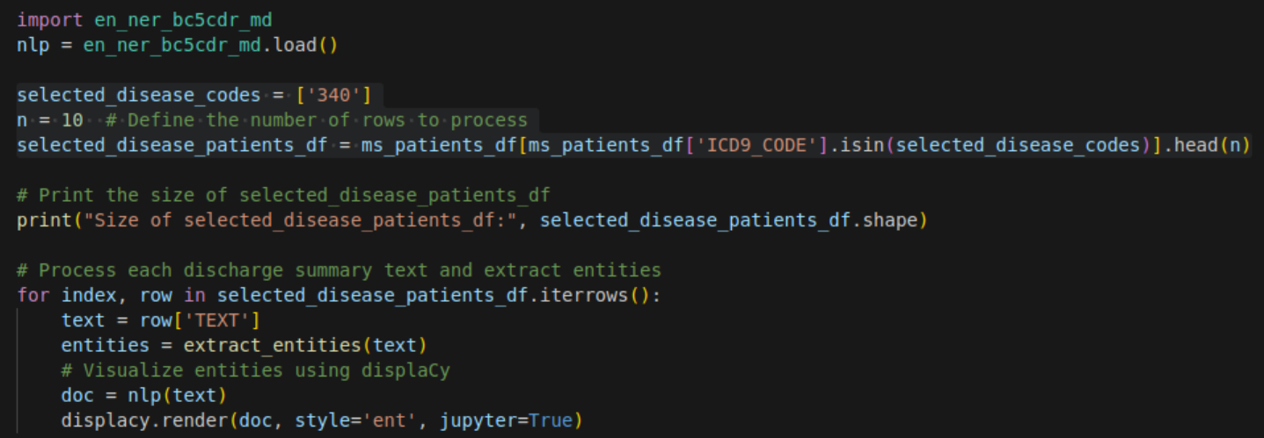
CODE: Using SciSpacy on M.S. Notes - en_ner_bc5cdr_md
Same as the previous code, but this time using the en_ner_bc5cdr_md model to do entity extraction on MS notes

Slide 20
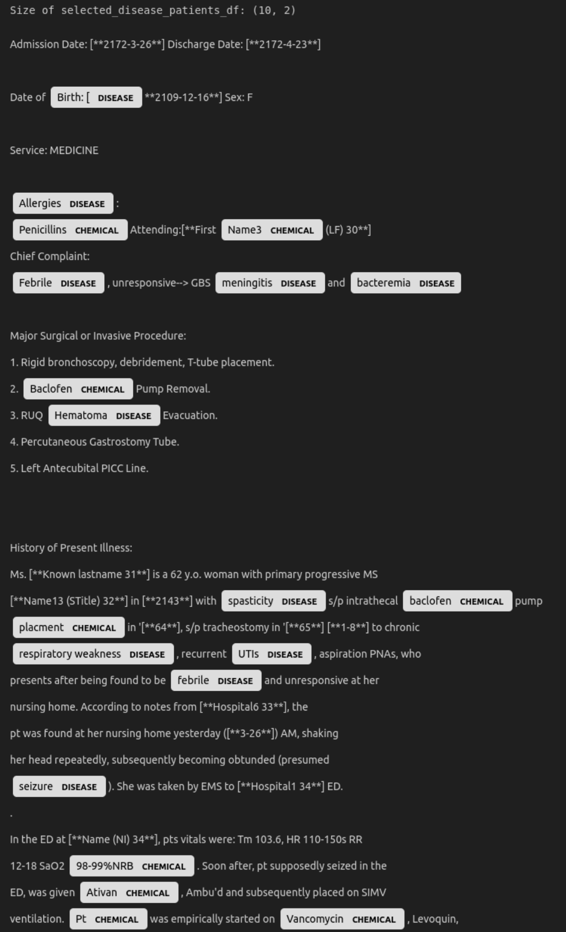
OUTPUT: Using SciSpacy on M.S. Notes - en_ner_bc5cdr_md
Picks up diseases and chemicals somewhat adequately, but certainly does not catch ever disease and chemical
Misses common diseases
Chemical labels can be correct, but can also be incorrect fairly frequently
Birth[ is not a disease, but is tagged as such
Missed drugs like Levoquin
Despite the parts that are less accurate, these results seem to be closer to useful

Slide 21
4. Word2Vec with Spacy and SciSpacy

Slide 22
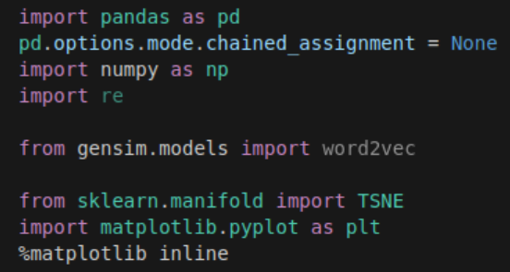
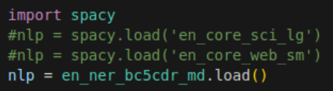
Importing packages, and loading the en_ner_bc5cdr_md dataset
Both of these are required to load the needed packages, as you can see we can use a variety of models for nlp here, but I’m using en_ner_bc5cdr_md since it seemed to work the best in my prior training

Slide 23
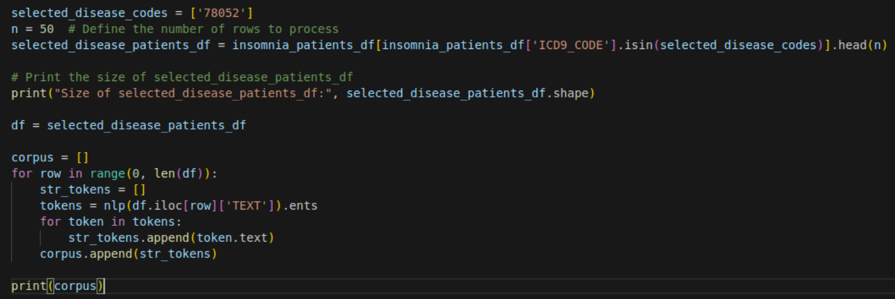
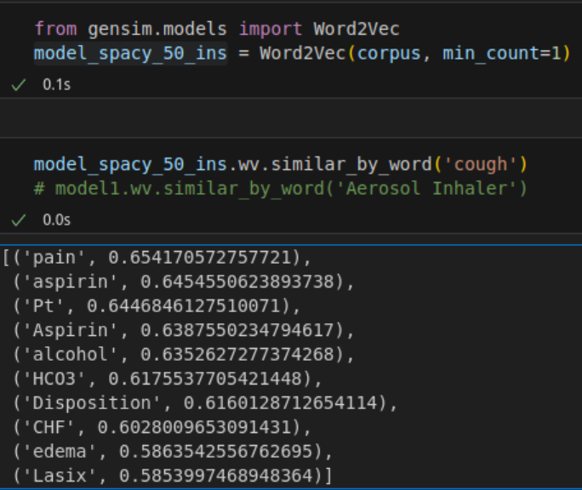
Using Word2Vec to generate a corpus and find similar words, and showing those outputs
This function gives fairly good matching for things related to ‘cough’

Slide 24
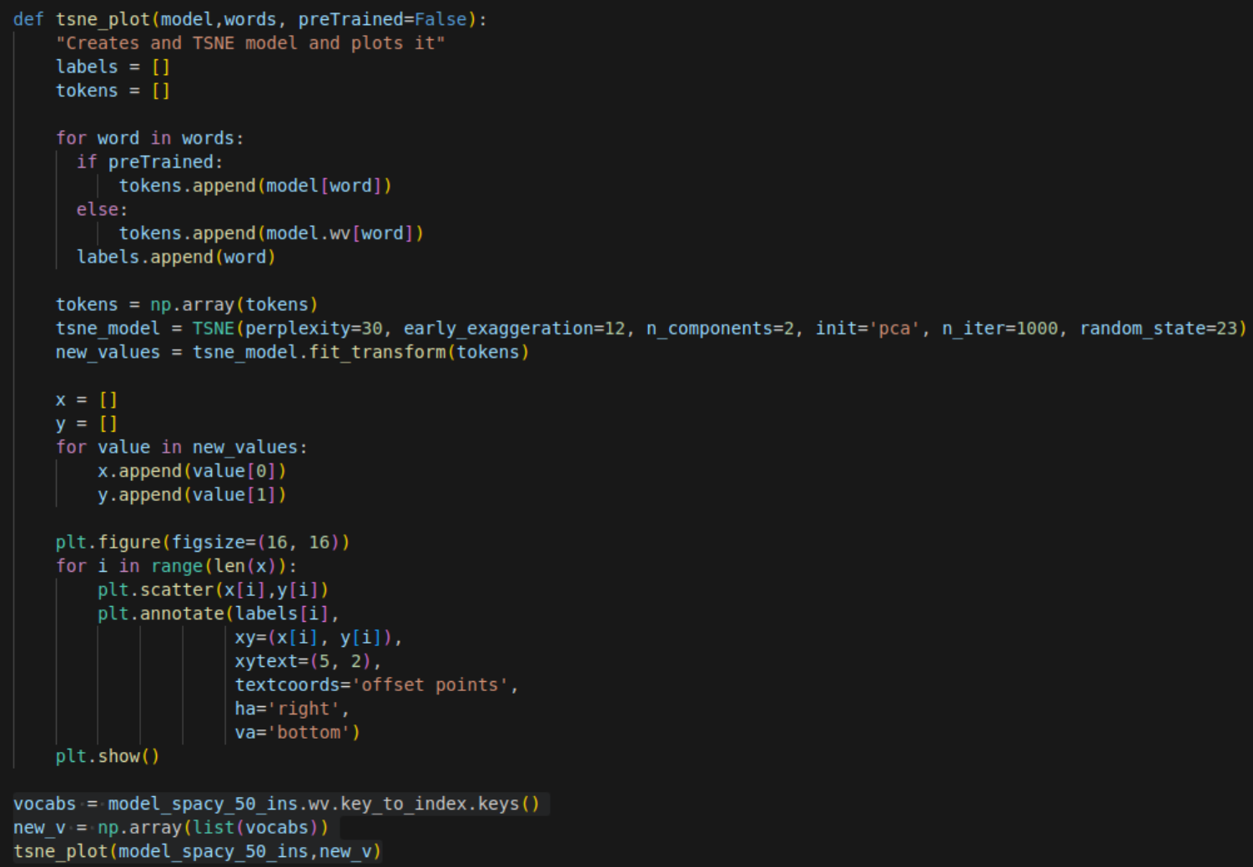
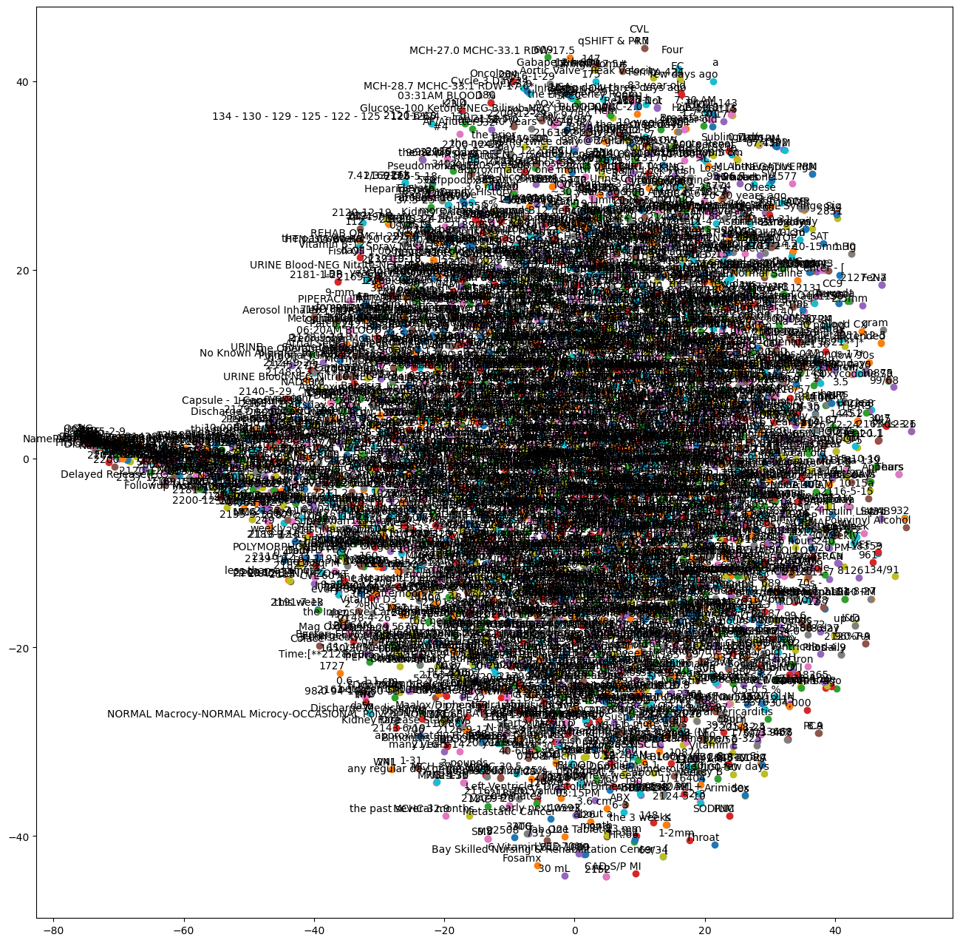
Plotting the Word2Vec outputs using T-SNE
This first graph was too cluttered, lets take the labels away to understand the graph shape, and then perhaps plot a sample

Slide 25
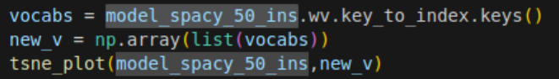
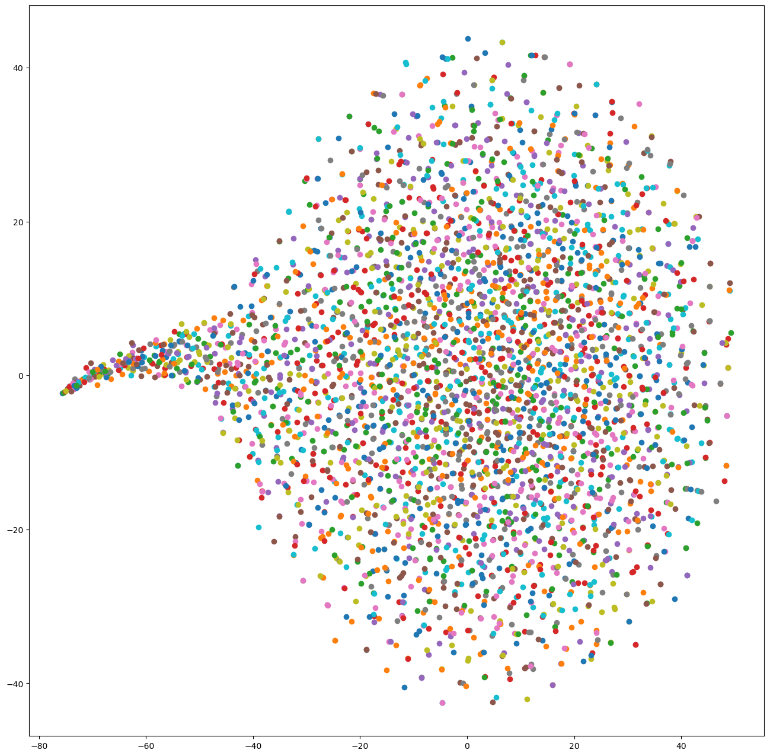
Word2Vec Unlabeled Diagrams
Unlabeled Data
This shows the concentration of some phrases similarities (likely numbers and related) compared to the circular array of words that were somewhat related
Let’s take a look at a labeled sample of these items to see how that displays

Slide 26
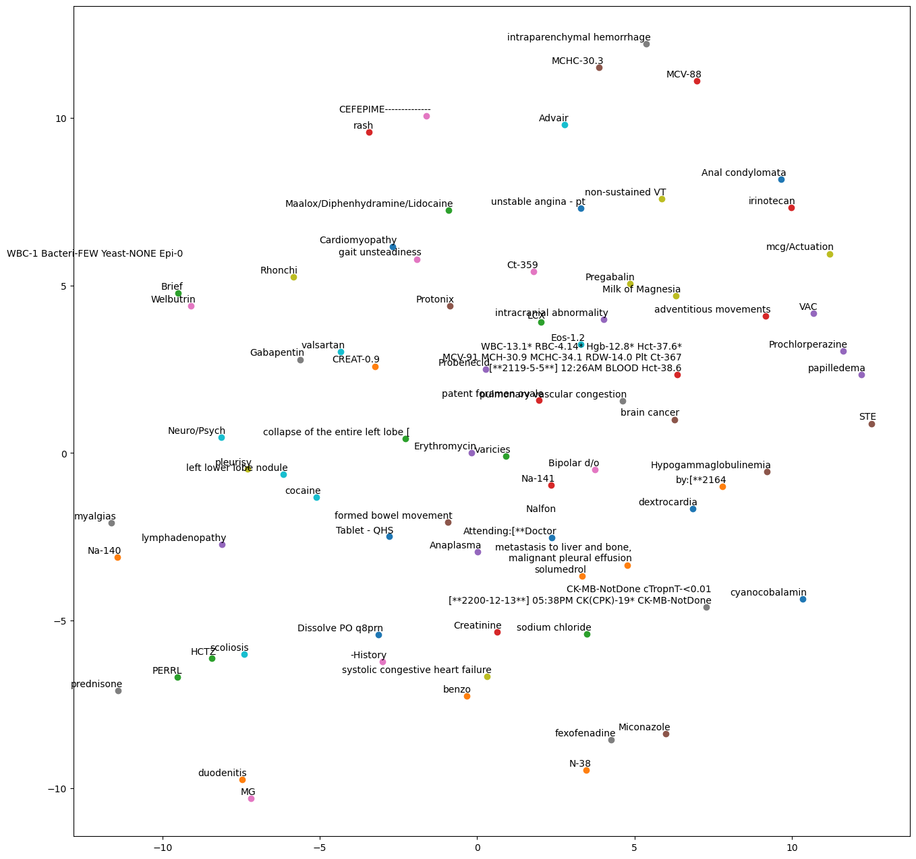
Word2Vec on 75 random samples of the chart note vectors
This is the output of the labeled random subset of terms
Closer semantic means are closer to each other
Does not hold the same shape of the original T-SNE
This shows some of the different options SciSpacey gives us for understanding and visualizing semantics of notes

Slide 27
5. Using a Pretrained Model

Slide 28
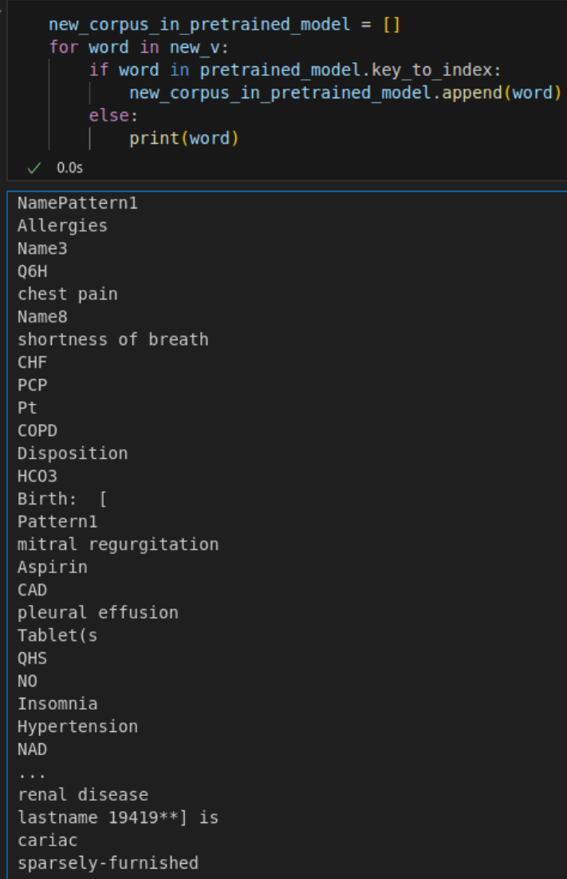
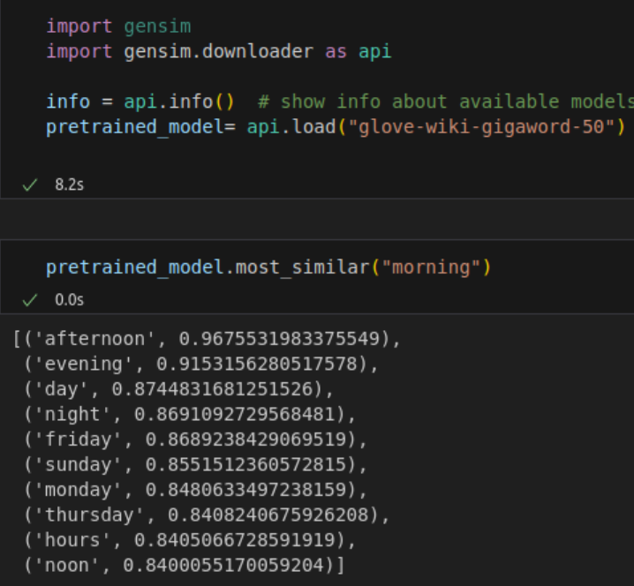
Downloading and testing glove-wiki-gigaword-50, and training a corpus
Much better matching results for “morning”
Corpus is seemingly fairly good
Many of the required vocab are being picked up

Slide 29
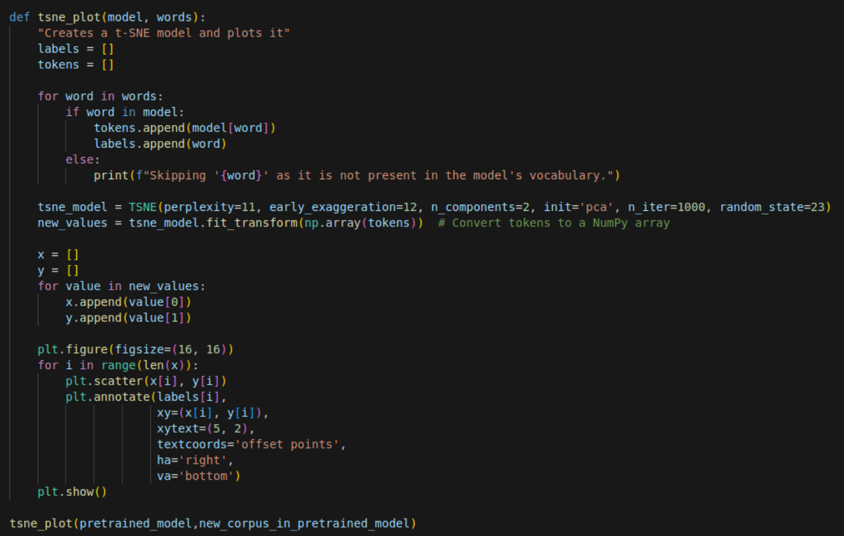
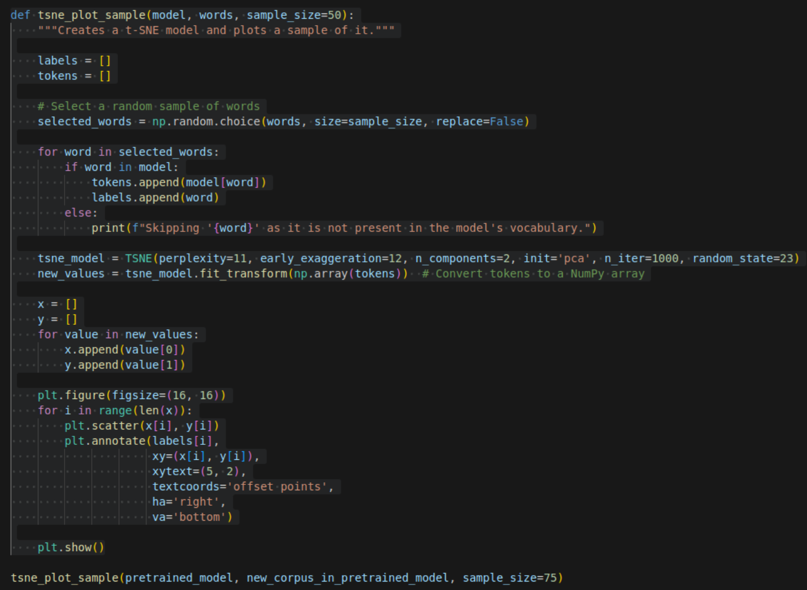
CODE: Plotting with a Pretrained Model

Slide 30
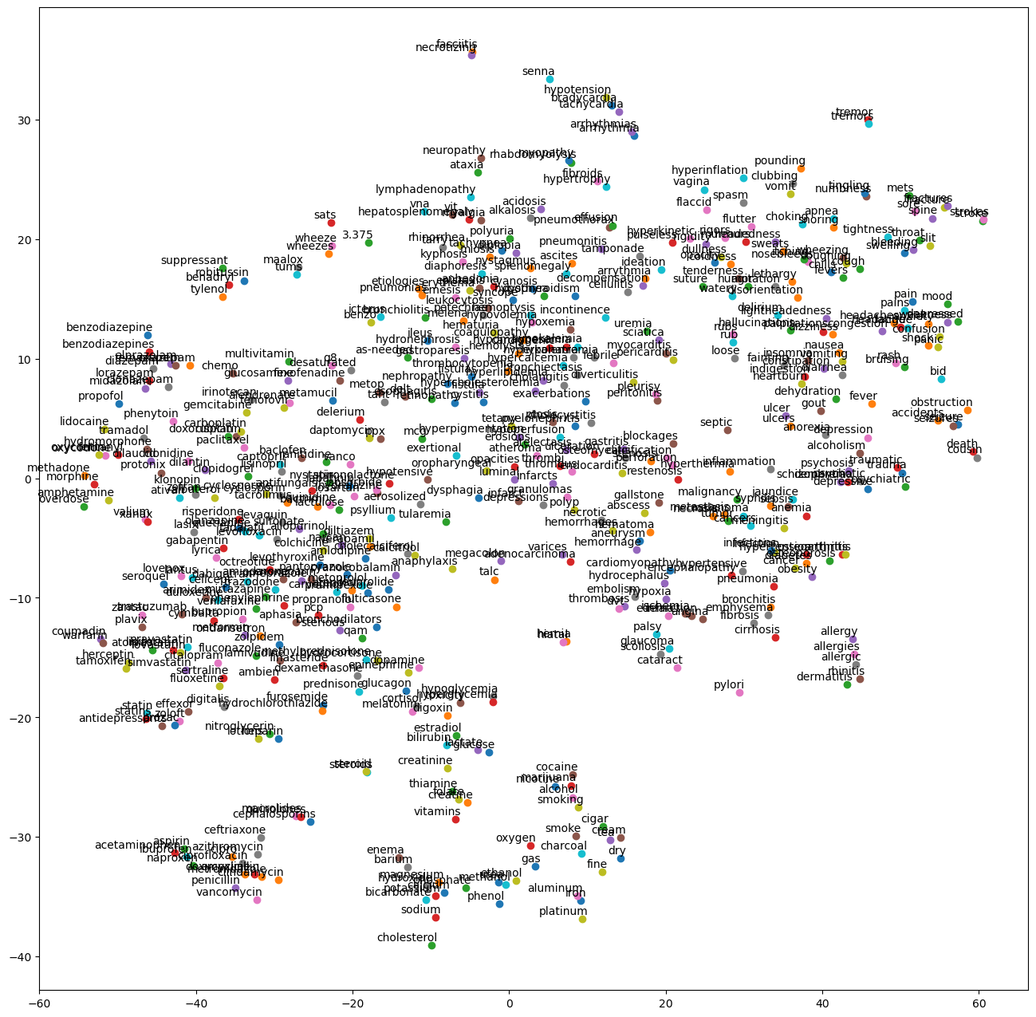
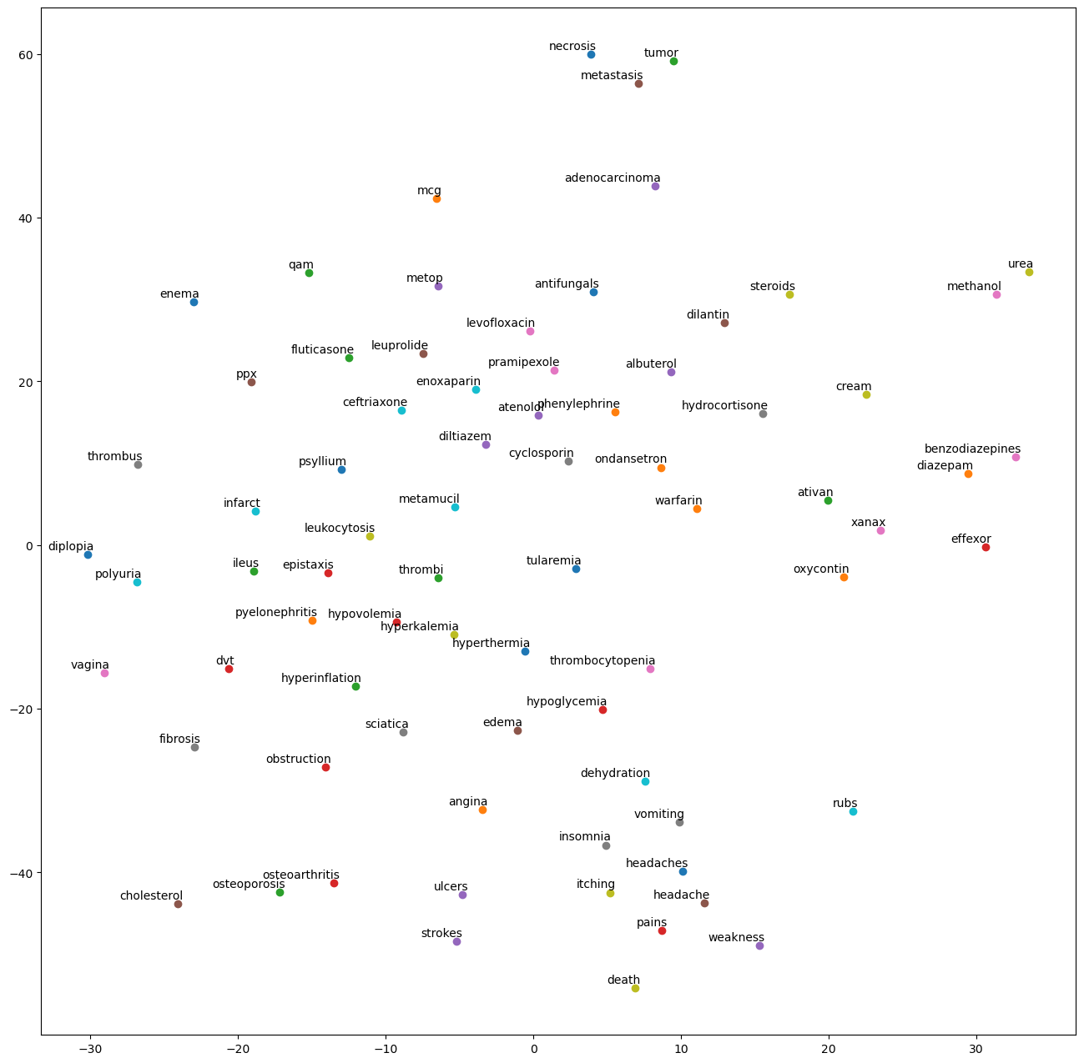
OUTPUT: Plotting with a Pretrained Model

Slide 31
BONUS: Using MedSpacy

Slide 32
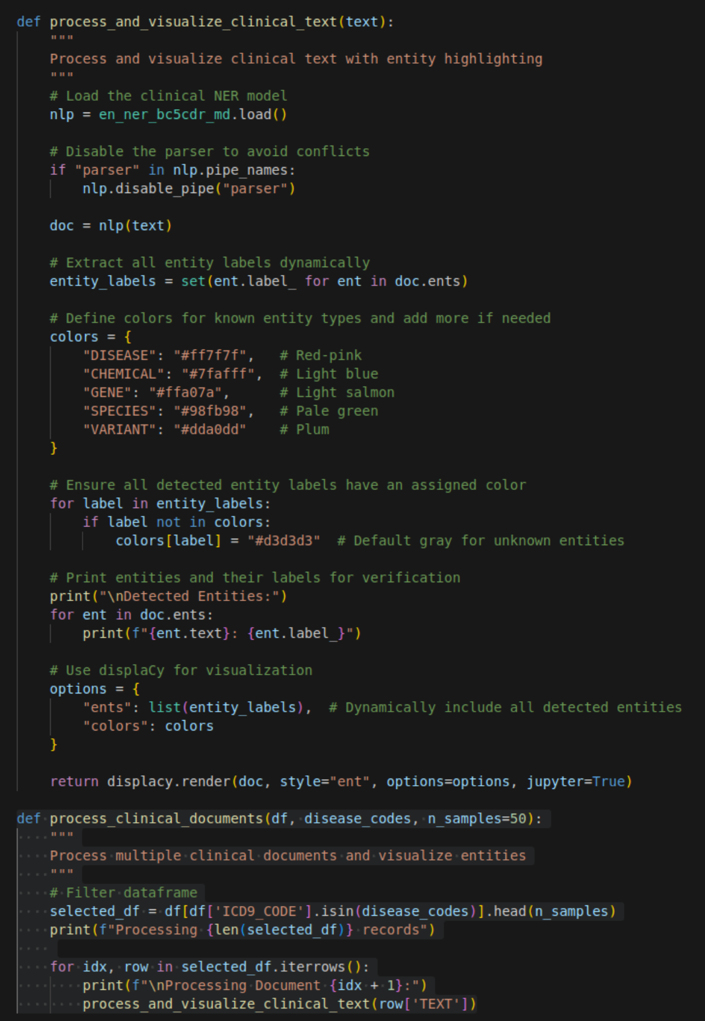
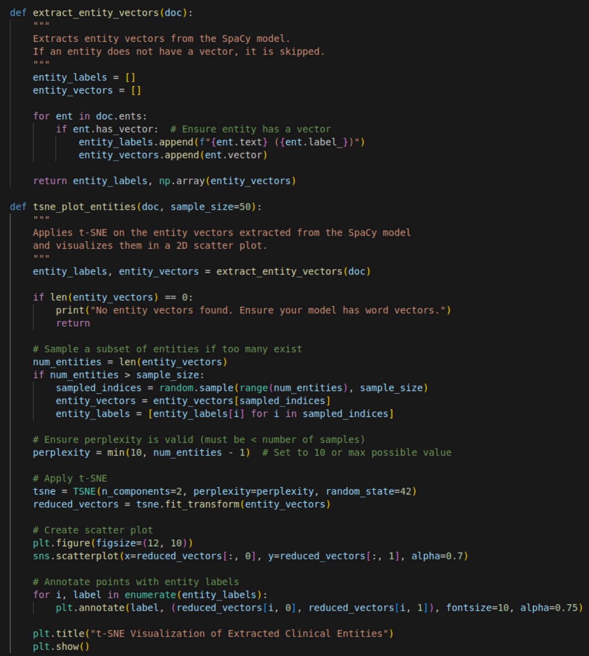
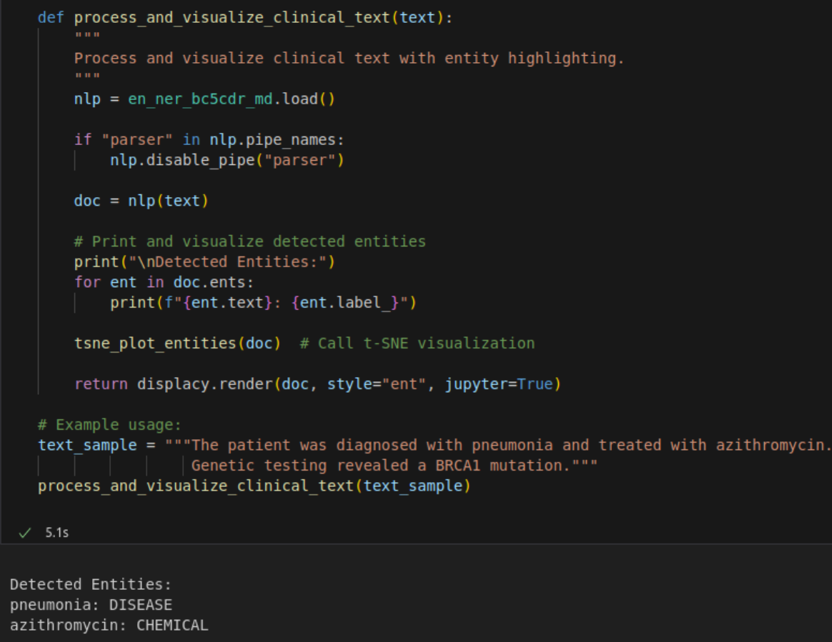
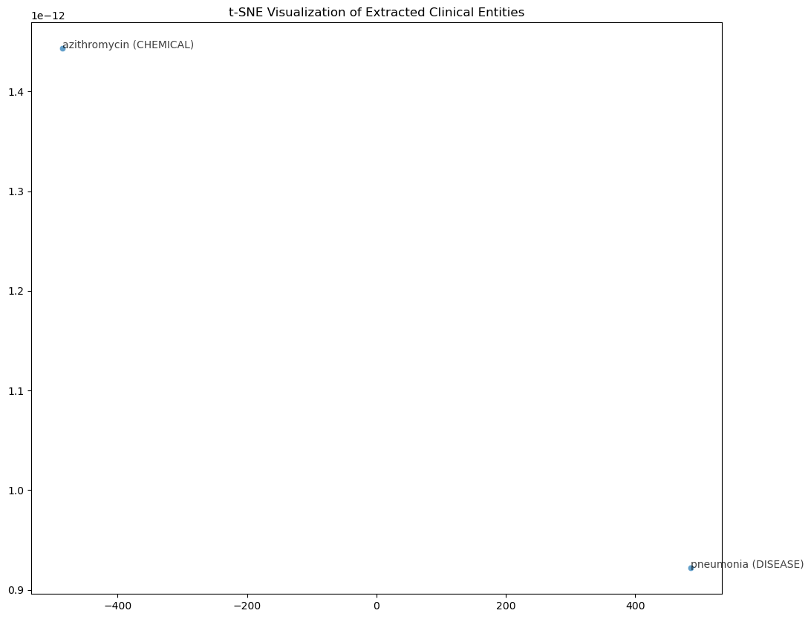
MedSpacy Environment Setup

Slide 33
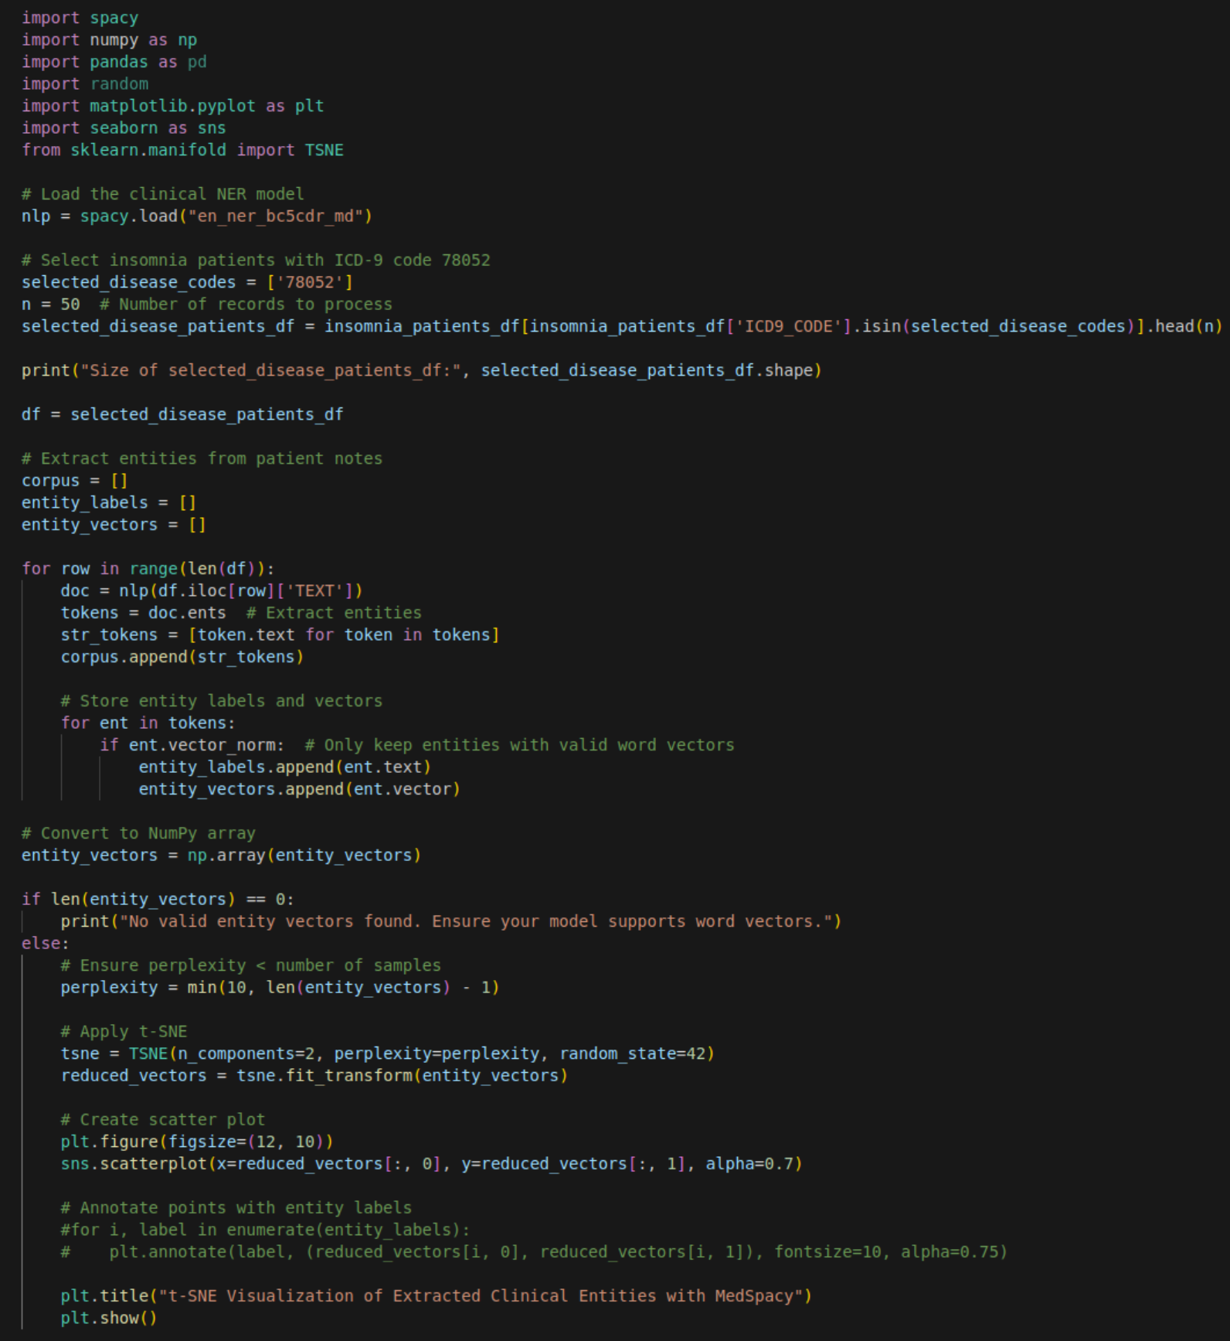
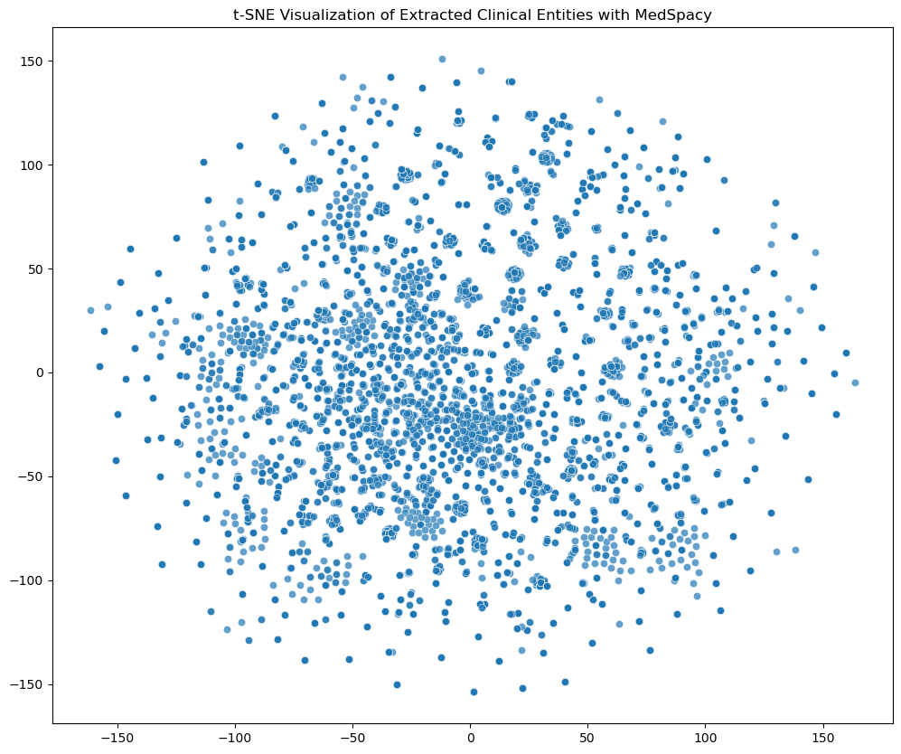
MedSpacy on Insomnia notes: t-SNE Visualization

Slide 34
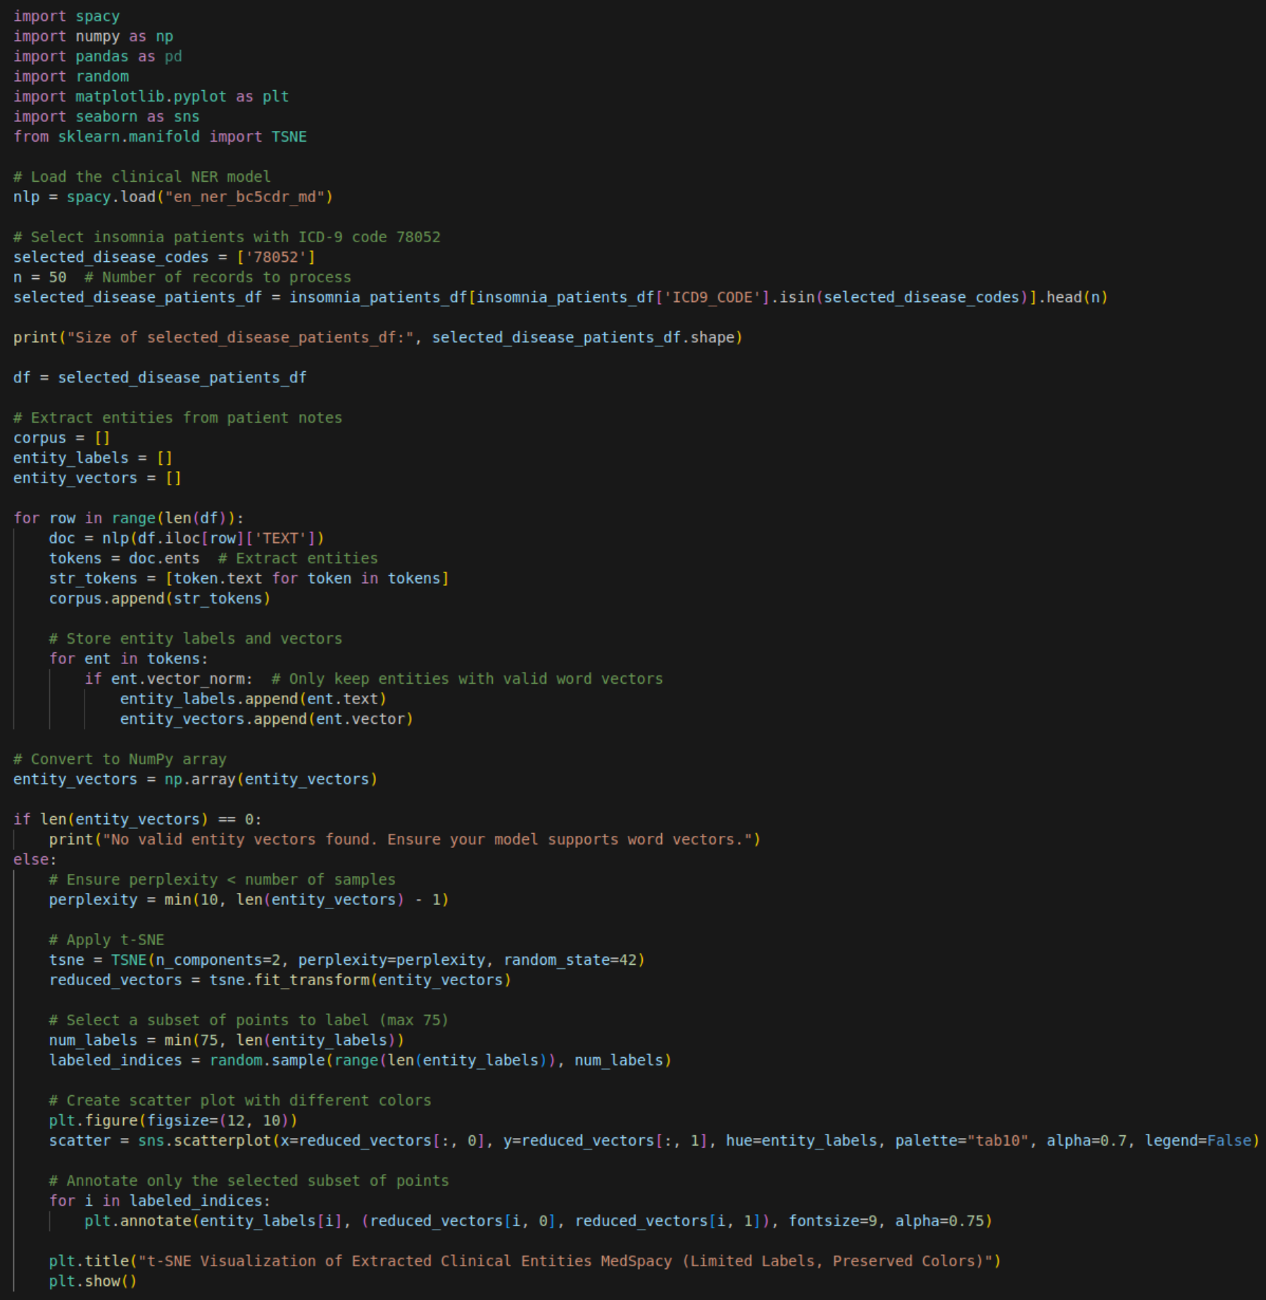
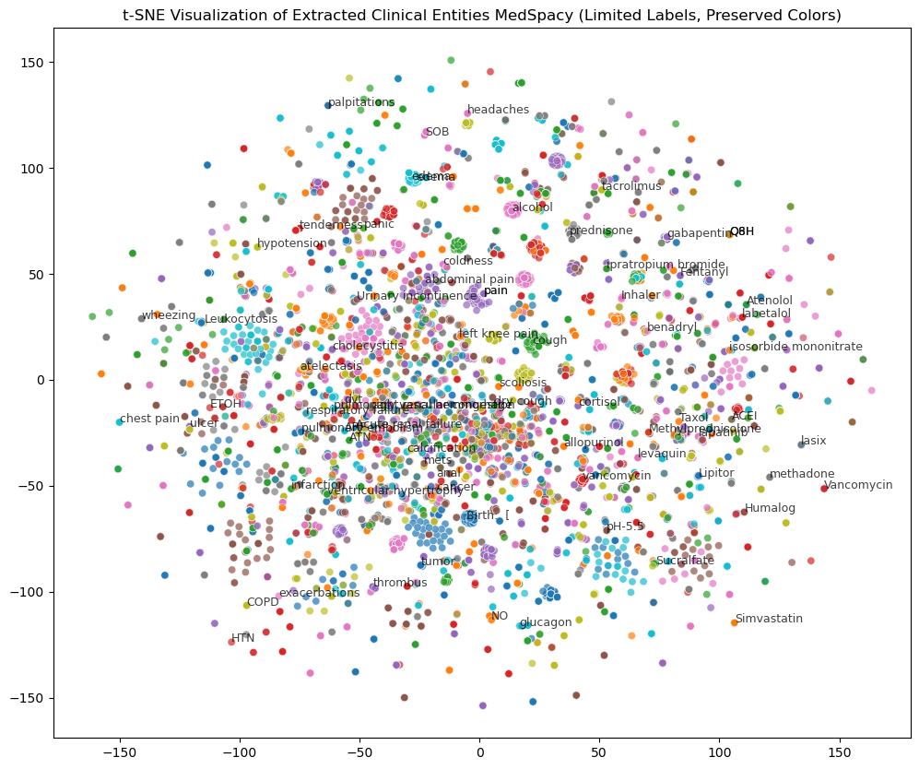
MedSpacy on Insomnia notes with Color Coding and clustering, with labeled samples

